Slide 1
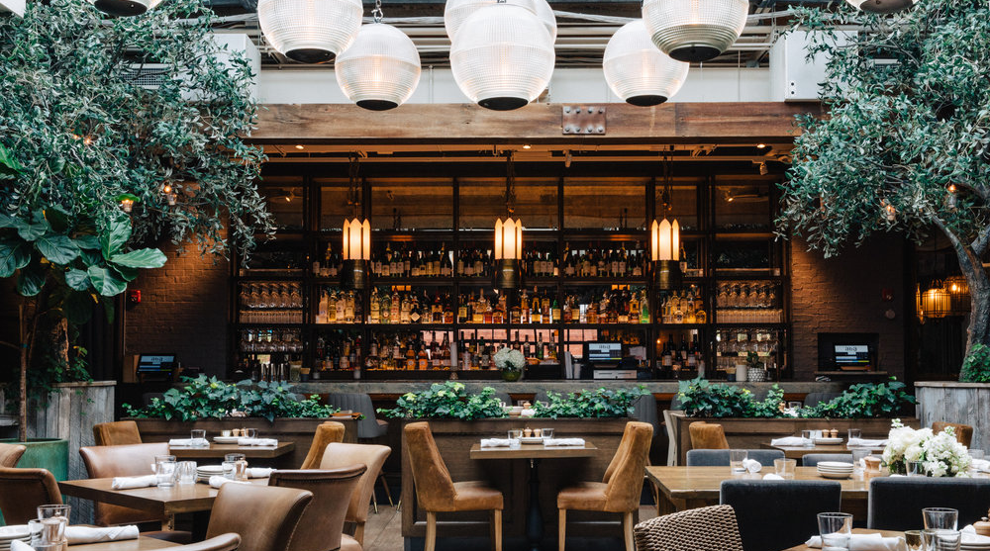
THE BEST RESTAURANT YOU’VE NEVER HEARD OF
LOCKHART LOUNGE
Presented By: The Daring Penguins

Slide 2
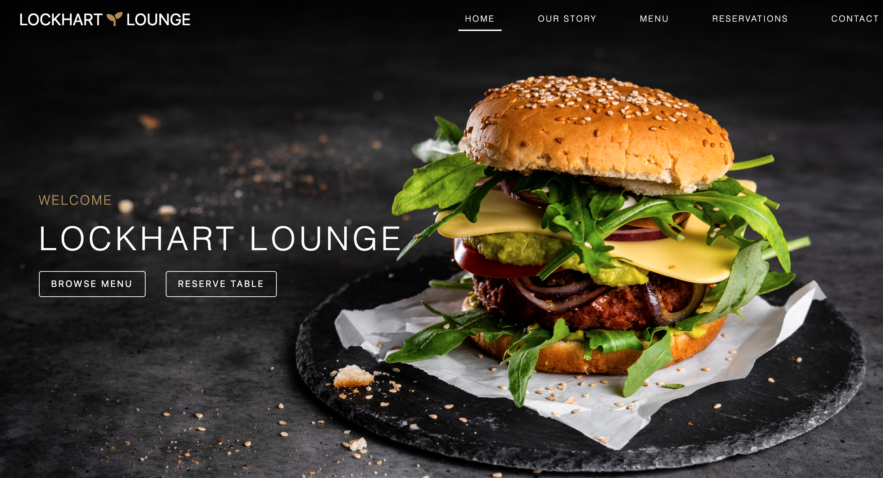
Digital Product
The Concept
Emphasize your main benefit
An all-in-one restaurant application that provides users with a way to book reservations, view menu items and order online with ease.
In a world that seems to never slow down, this application proves to be an effective solution for making the restaurant experience that much more simplistic.

Slide 3

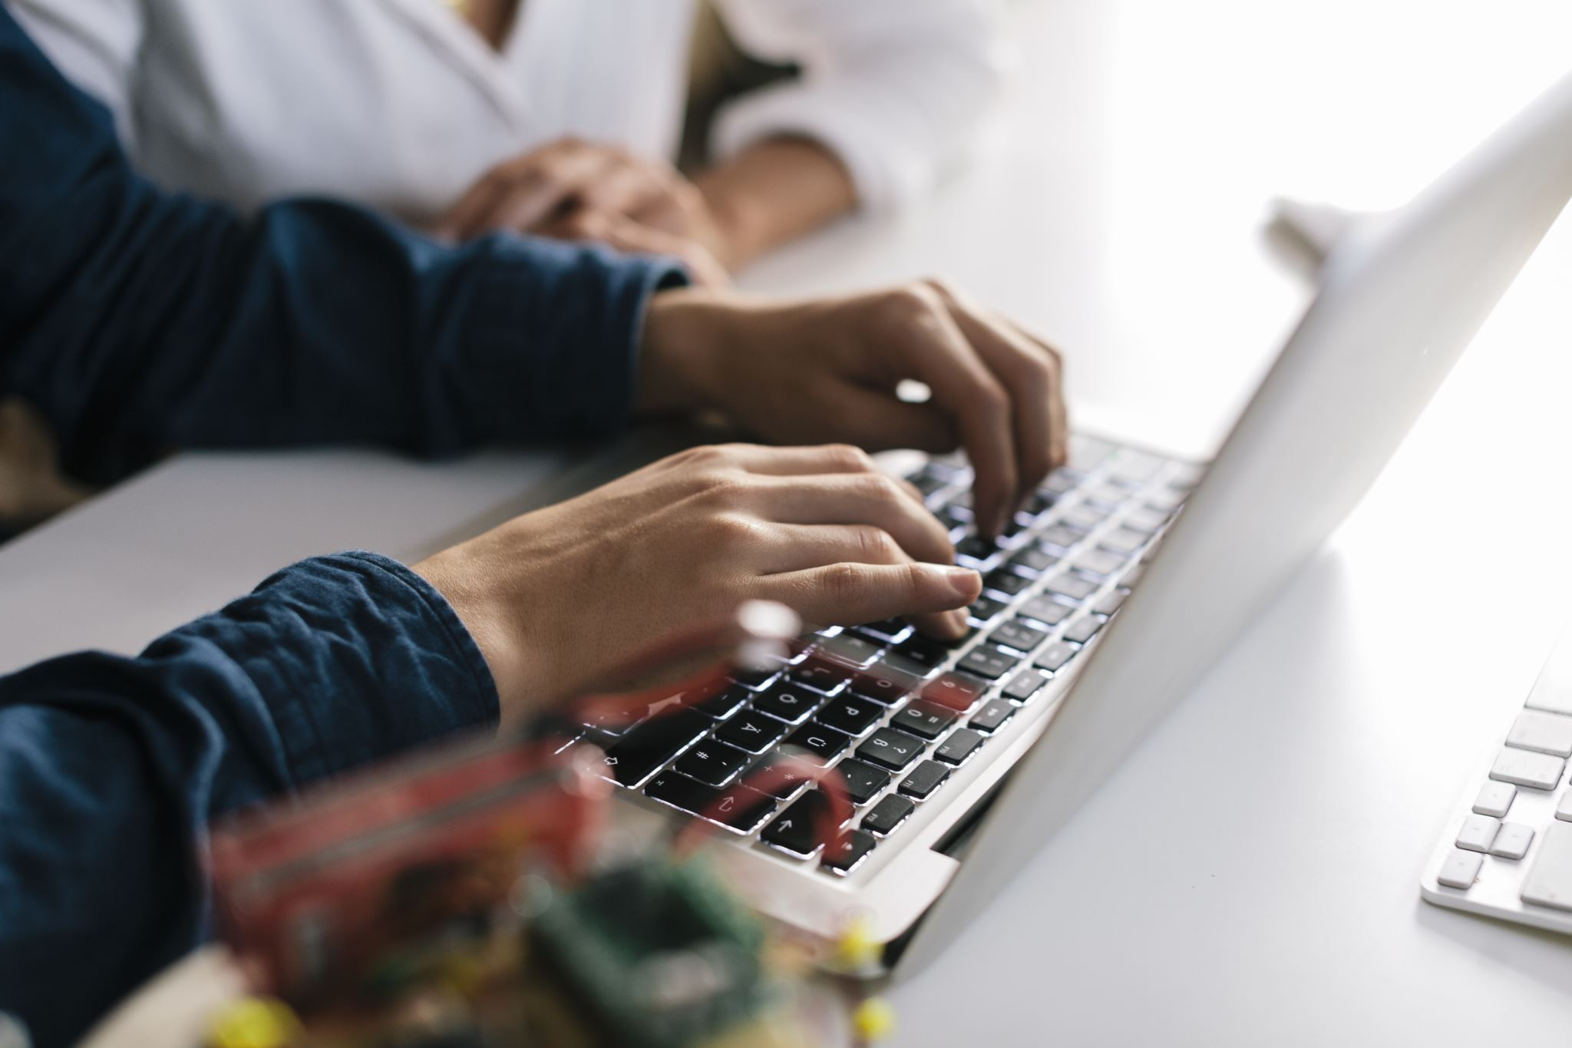



The Design Process
Productivity
User Frustration
Mobile Finance
Chip Pricing
Scarce Analytics
Divided into a front-end and back-end team
Focused on our respective tasks and communicated regularly to ensure cohesiveness
Merged the back-end functionality with the front-end code
Debugged any errors and ensured application was running optimally both on the front and back ends
Deployed successfully to Heroku & ran a few final tests to ensure app was running properly

Slide 4






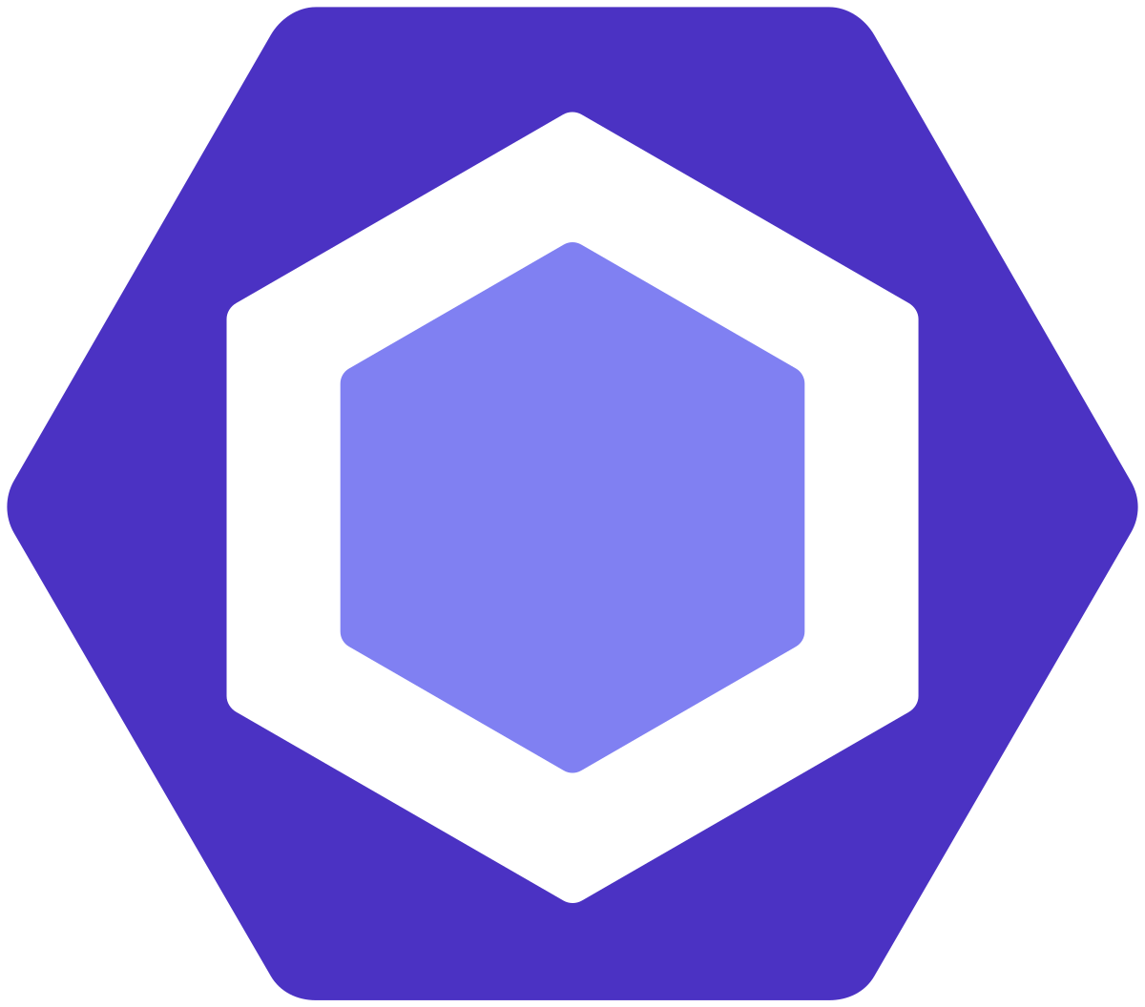
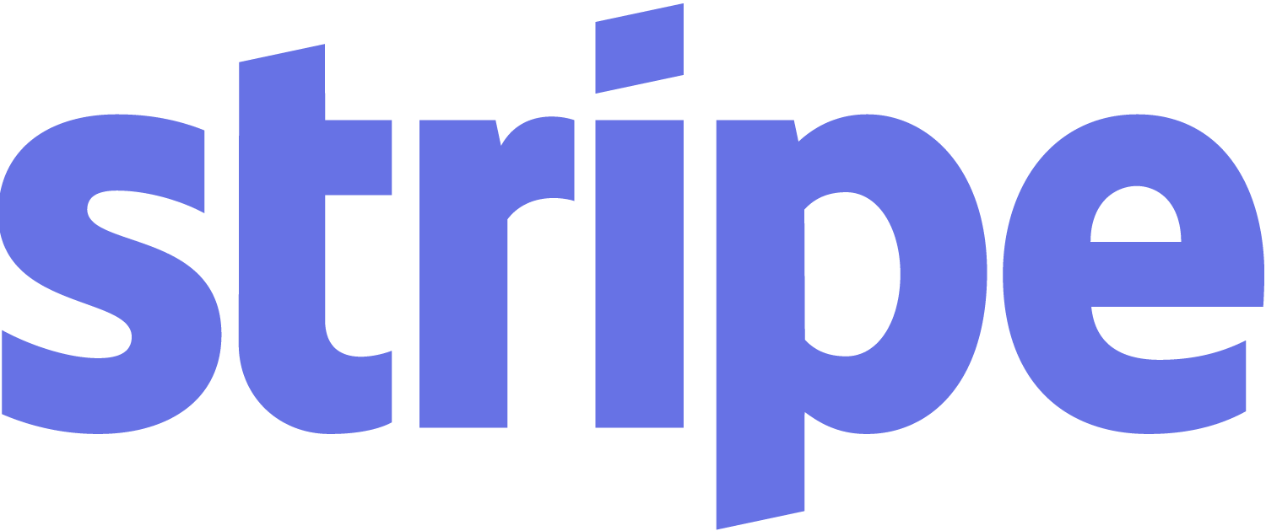





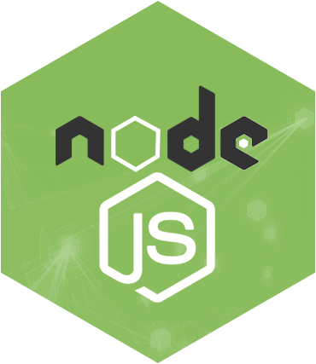
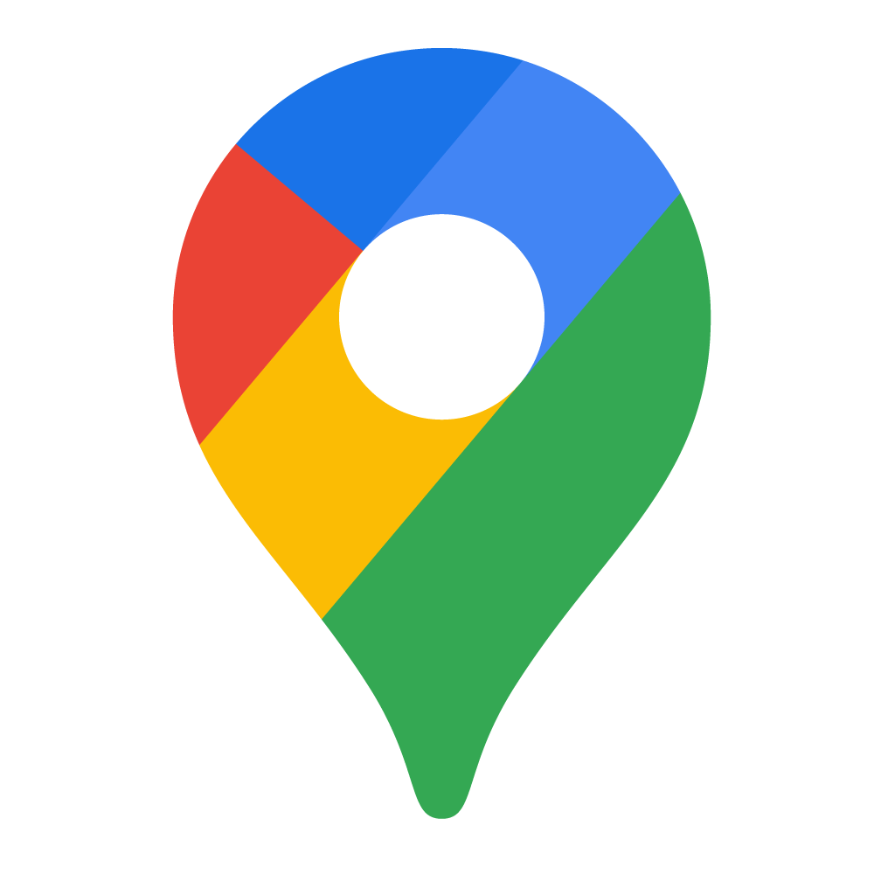
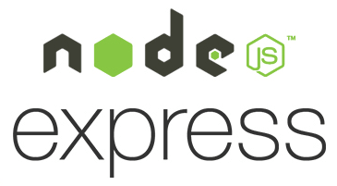
Technologies Used

Slide 5
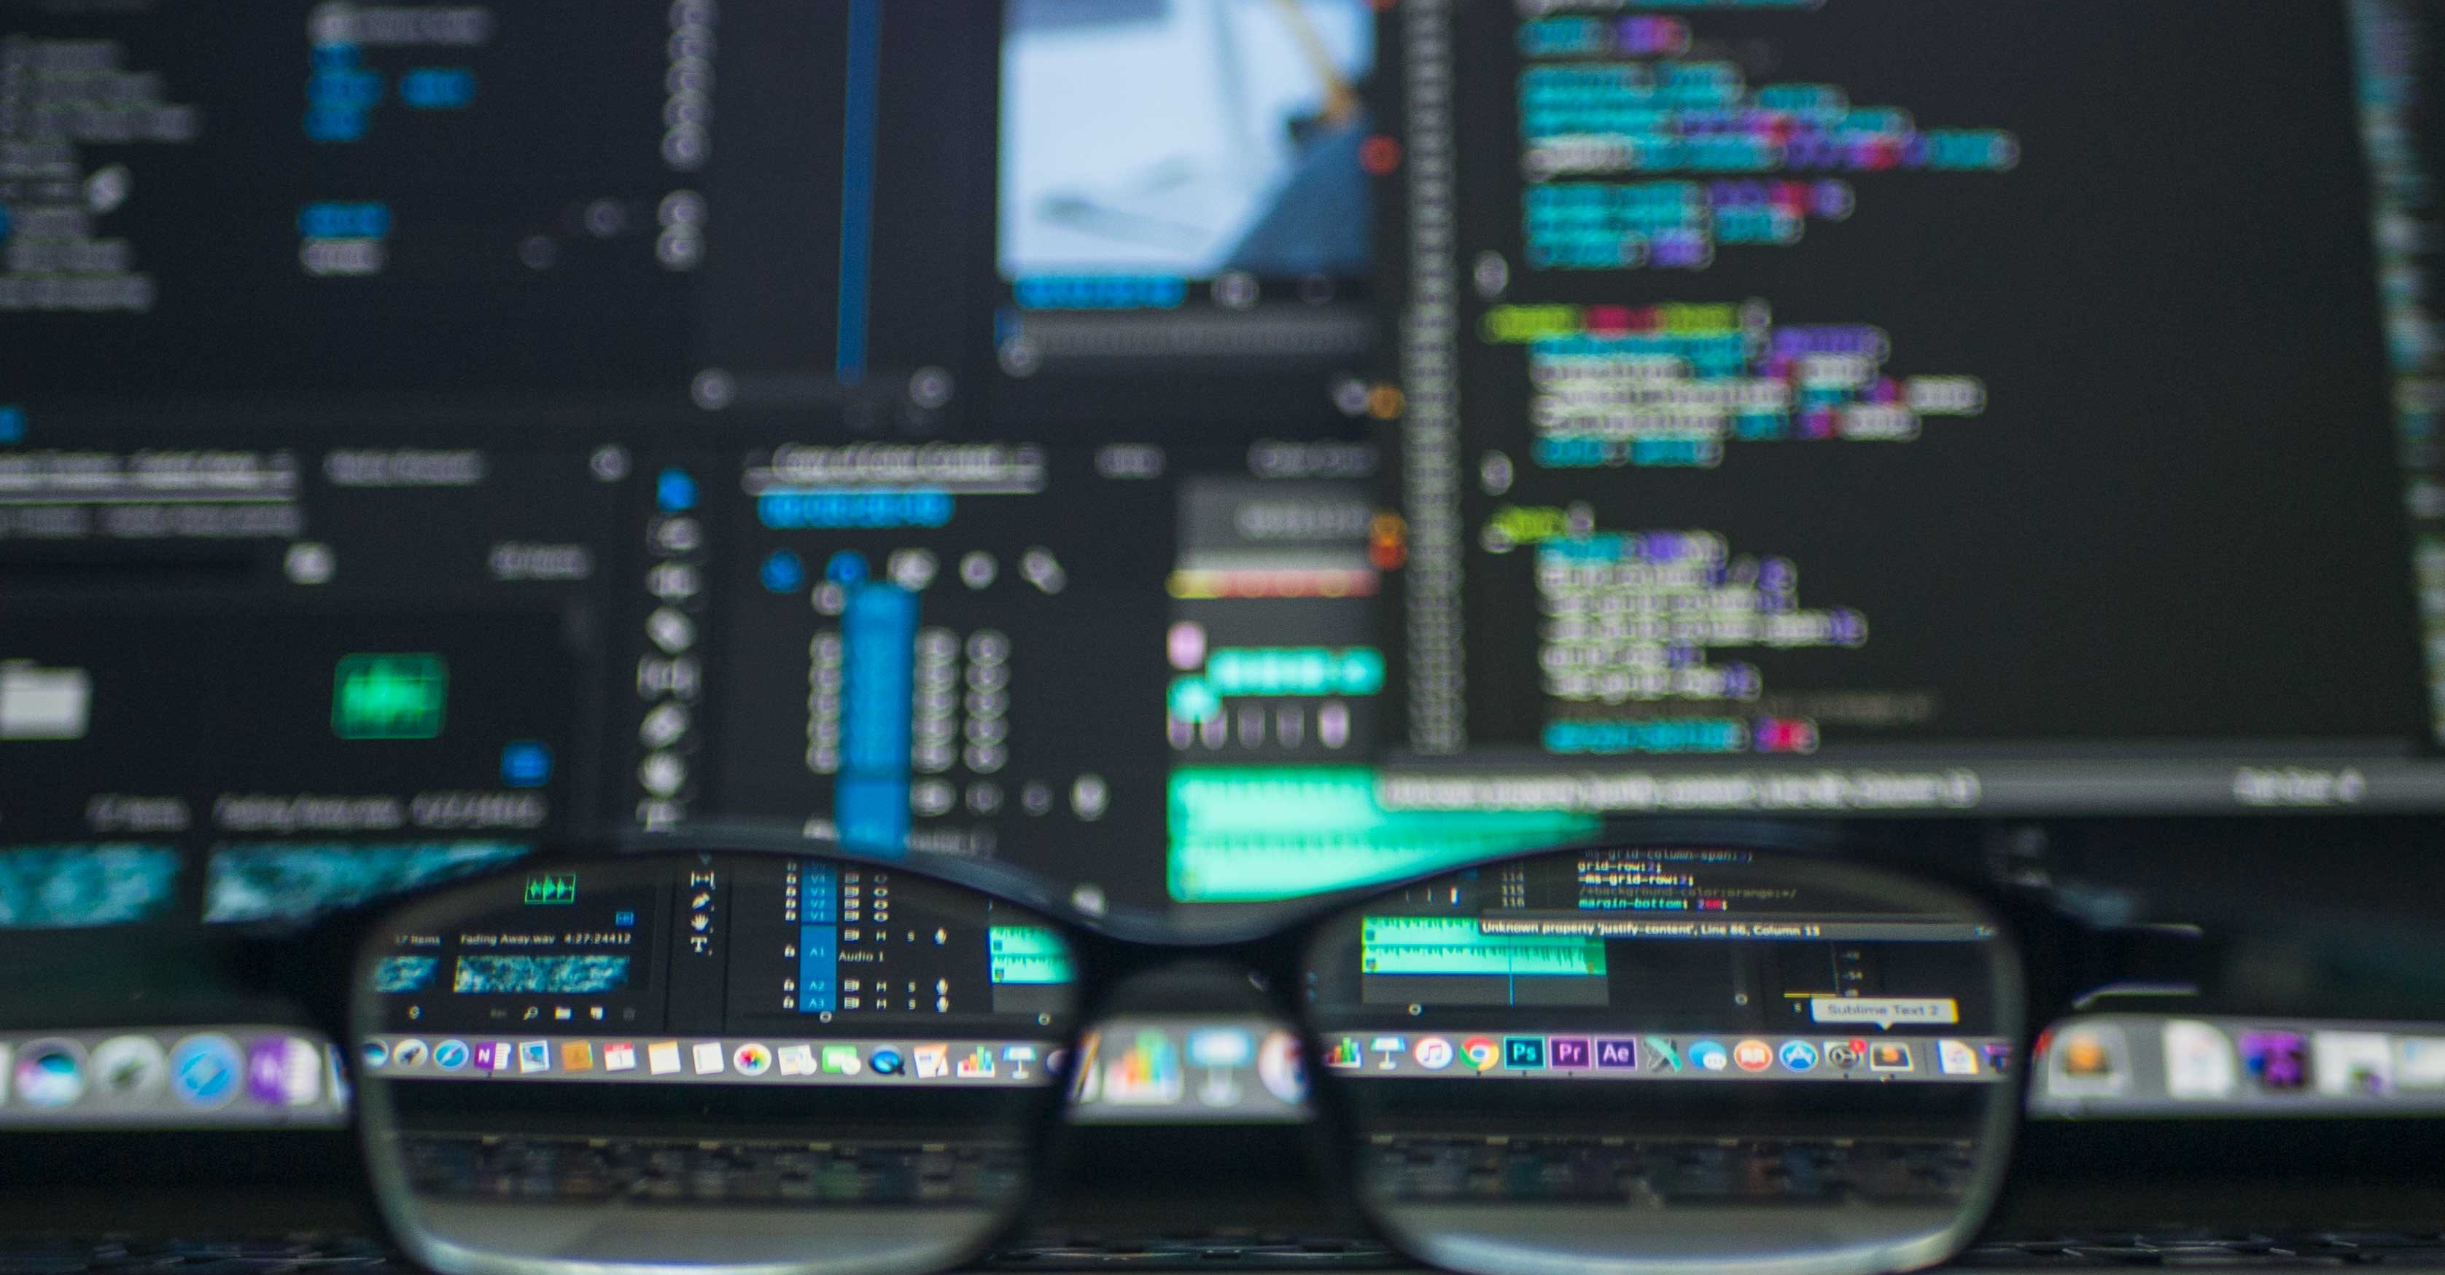
Demonstration
*Link to Deployed Application

Slide 6
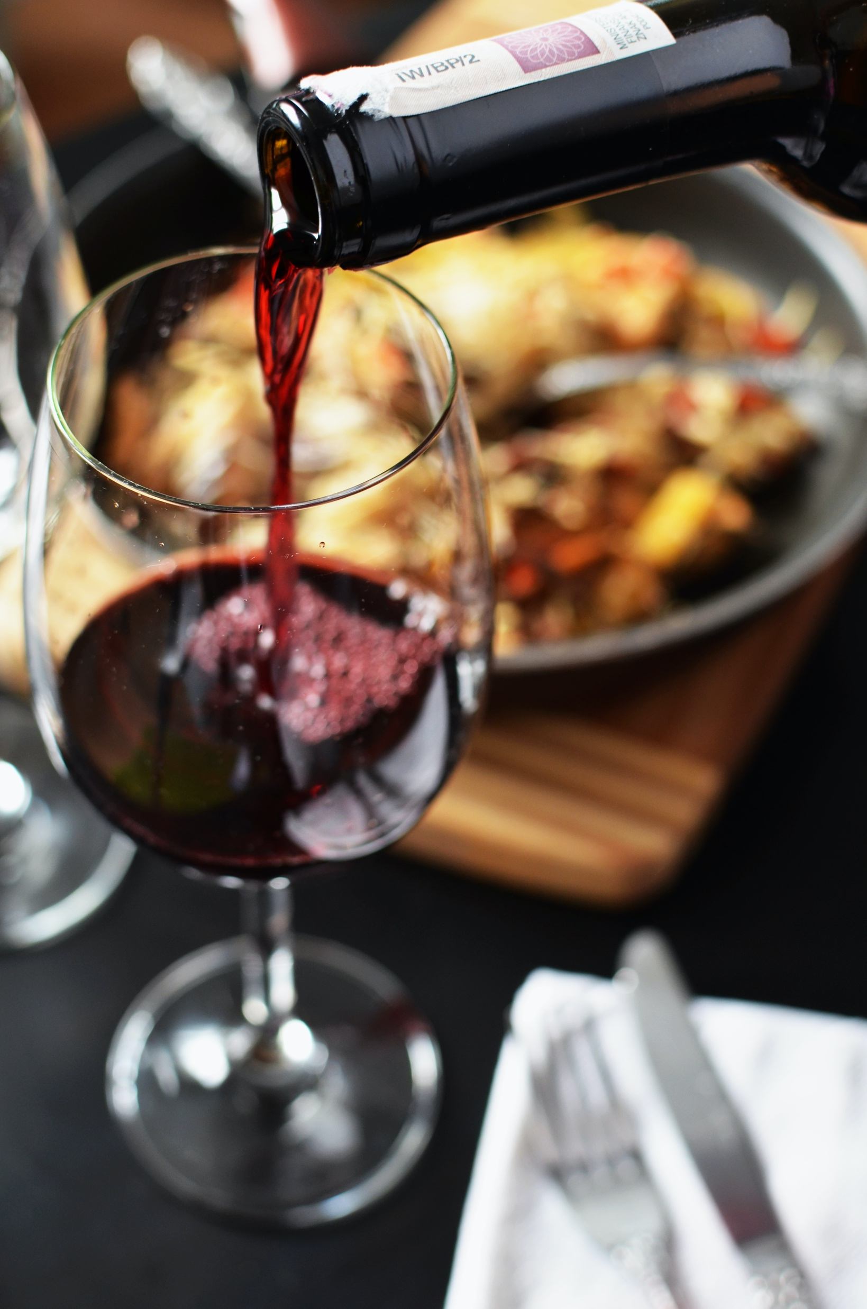
Future Development
What’s still in store for Lockhart Lounge?
Front-end display of reservation list
Guest portal
Easy-submission contact form
Enhanced styling and animations

Slide 7
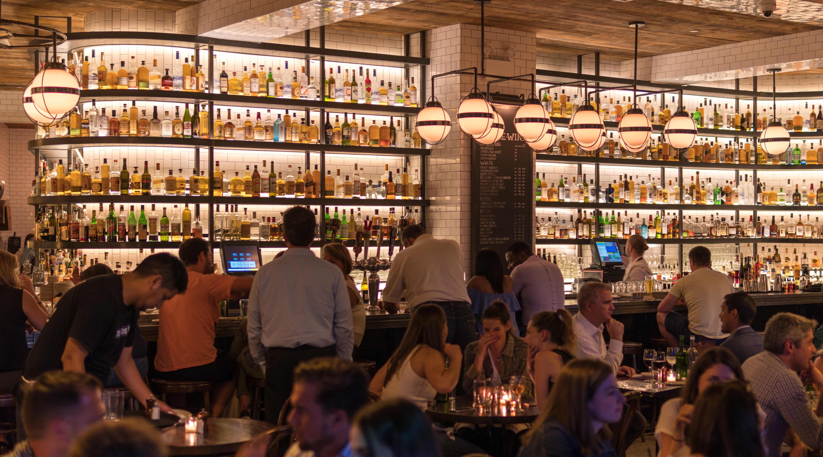
Questions?
Thank you for
your time

